Slide 1

Advance Technology Cloud Computing
Team No: 03
Team Name: Team-A
Center Name: KHARGHAR

Slide 2
Introduction to Cloud Computing
Cloud Computing is a general term used to describe a new class of network based computing that takes place over the Internet, basically a step on from Utility Computing a collection/group of integrated and networked hardware, software and Internet infrastructure (called a platform). Using the Internet for communication and transport provides hardware, software and networking services to clients These platforms hide the complexity and details of the underlying infrastructure from users and applications by providing very simple graphical interface or API (Applications Programming Interface).

Slide 3
What is Cloud Computing?
In addition, the platform provides on demand services, that are always on, anywhere, anytime and any place. Pay for use and as needed, elastic scale up and down in capacity and functionalities The hardware and software services are available to general public, enterprises, corporations and businesses markets

Slide 4
Basic Concepts
There are certain services and models working behind the scene making the cloud computing feasible and accessible to end users. Following are the working models for cloud computing:
1. Deployment Models
2. Service Models

Slide 5
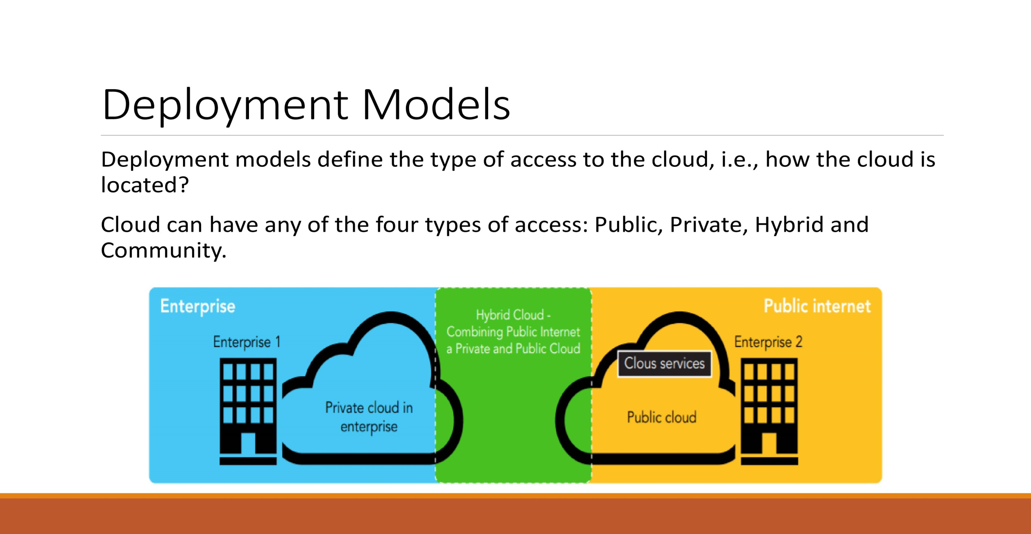

Slide 6
Deployment Models
PUBLIC CLOUD : The Public Cloud allows systems and services to be easily accessible to the general public. Public cloud may be less secure because of its openness, e.g., e-mail.
PRIVATE CLOUD : The Private Cloud allows systems and services to be accessible within an organization. It offers increased security because of its private nature.
COMMUNITY CLOUD : The Community Cloud allows systems and services to be accessible by group of organizations.
HYBRID CLOUD : The Hybrid Cloud is mixture of public and private cloud. However, the critical activities are performed using private cloud while the non- critical activities are performed using public cloud.

Slide 7
Service Models
Service Models are the reference models on which the Cloud Computing is based.
These can be categorized into three basic service models as listed below:
Infrastructure as a Service (laaS)
Platform as a Service (PaaS)
Software as a Service (SaaS)

Slide 8
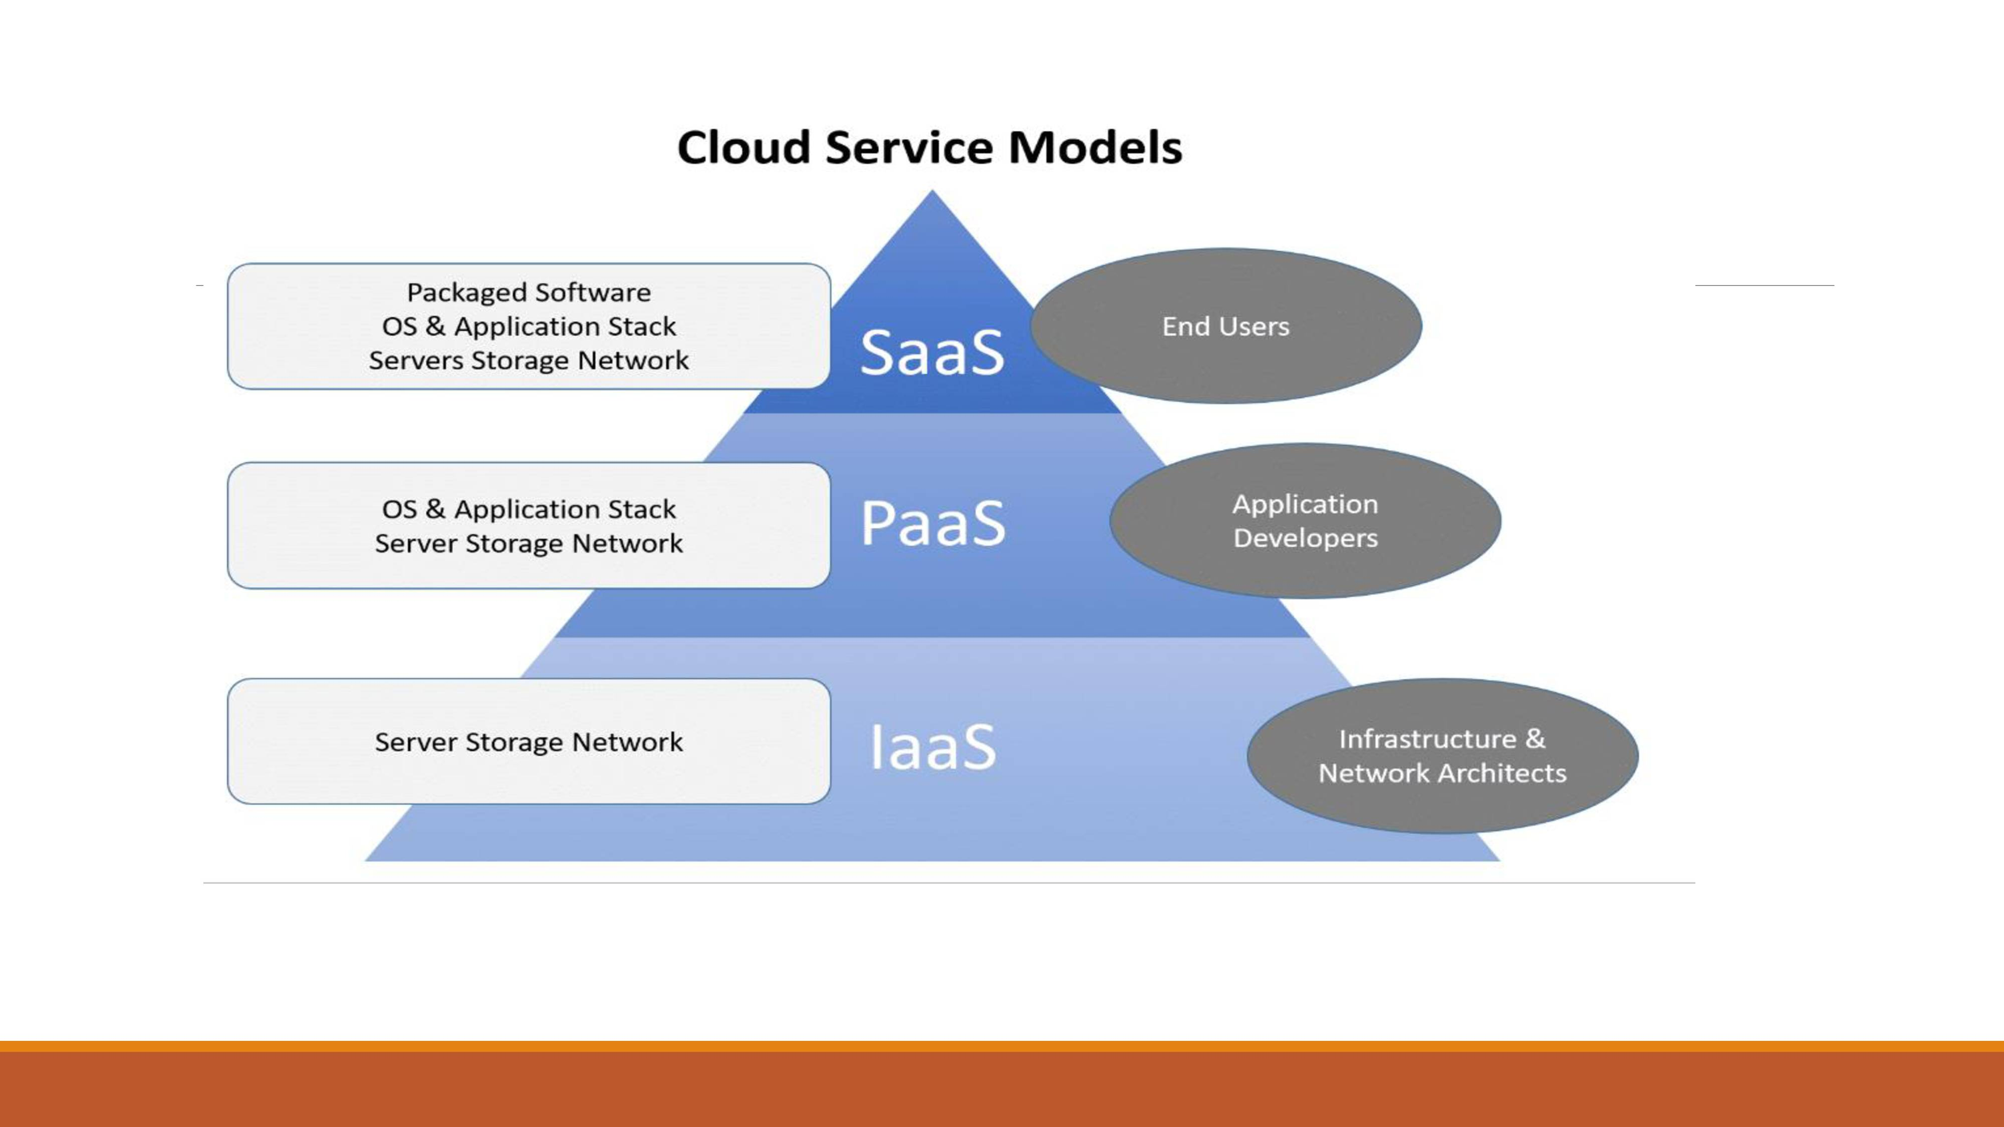

Slide 9
Infrastructure as a Service (laaS)
laaS is the delivery of technology infrastructure as an on demand scalable service. laaS provides access to fundamental resources such as physical machines, virtual machines, virtual storage, etc.
Usually billed based on usage
Usually multi tenant virtualized environment
Can be coupled with Managed Services for OS and application support

Slide 10
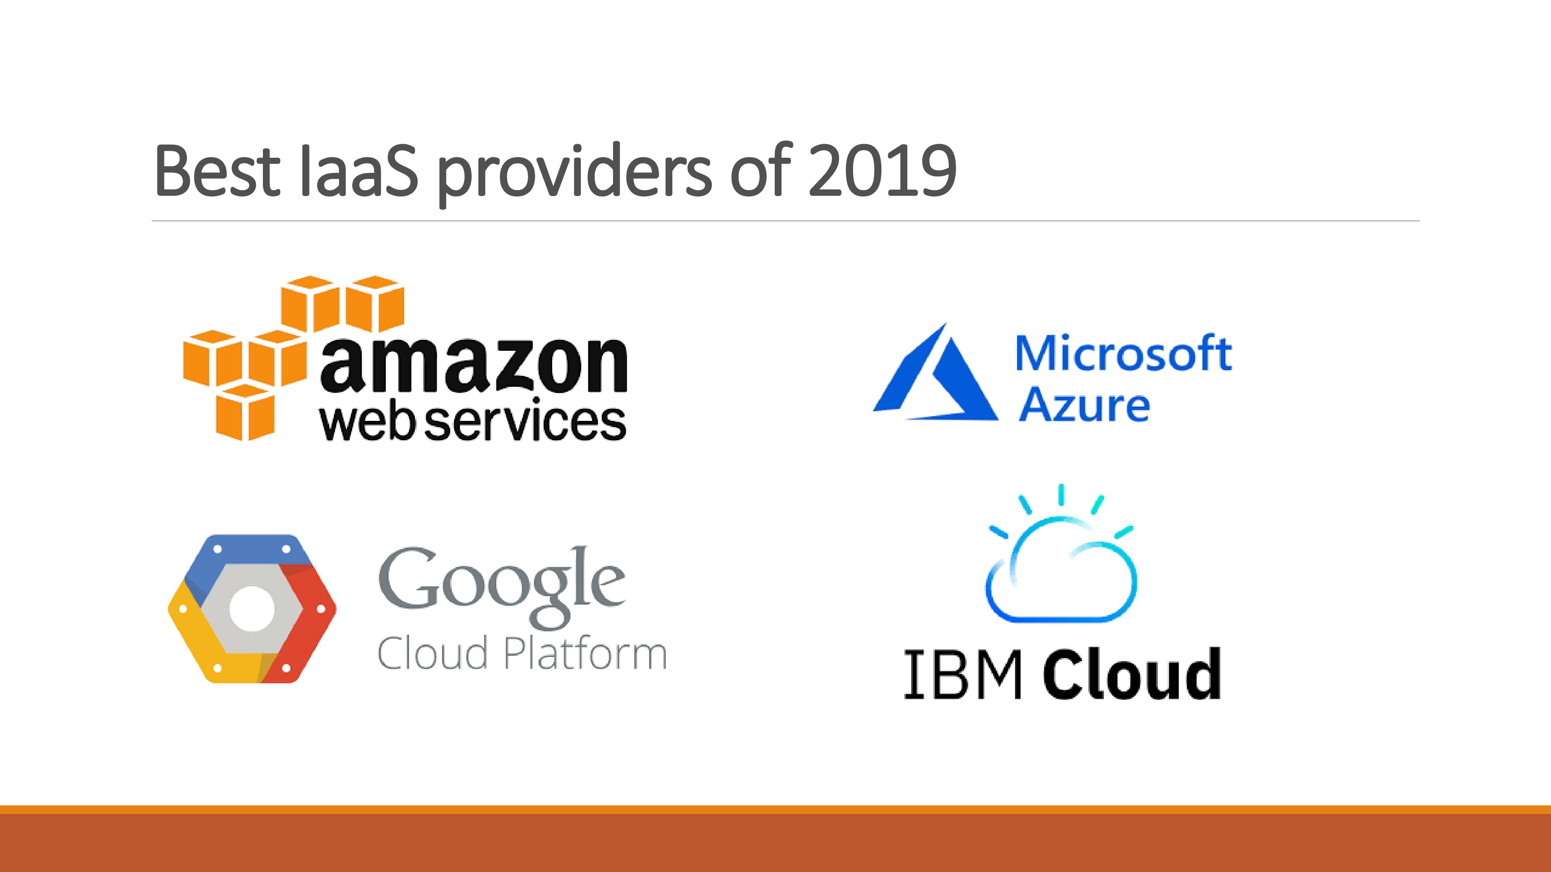

Slide 11
Platform as a Service (PaaS)
PaaS provides the runtime environment for applications, PaaS provides development & deployment tools, etc. PaaS provides all of the facilities required to support the complete life cycle of building and delivering web applications and services entirely from the Internet.
Typically applications must be developed with a particular platform in mind.
Multi tenant environments
Highly scalable multi tier architecture

Slide 12
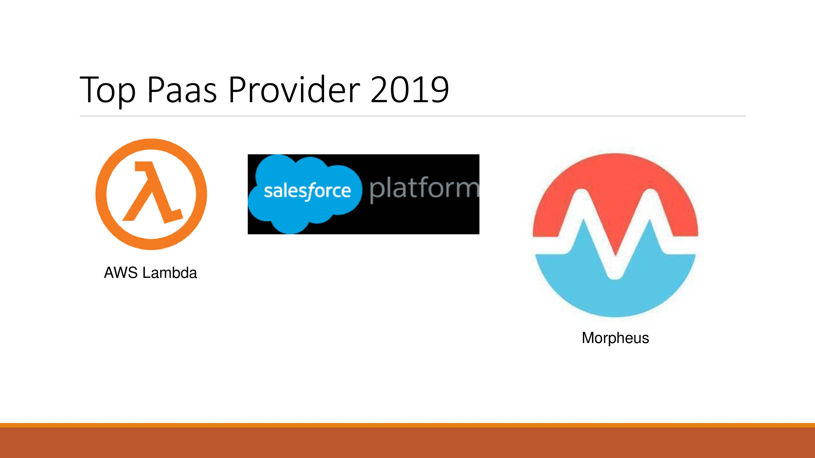

Slide 13
Software as a Service (SaaS)
SaaS model allows to use software applications as a service to end users. SaaS is a software delivery methodology that provides licensed multi-tenant access to software and its functions remotely as a Web-based service.
Usually billed based on usage
Usually multi tenant environment
Highly scalable architecture

Slide 14
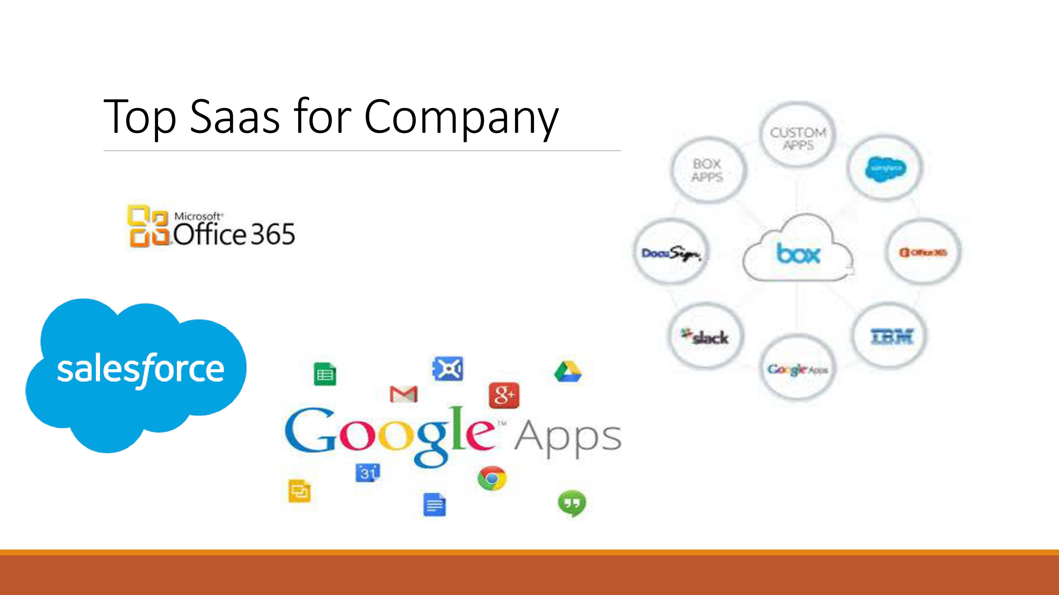

Slide 15
Virtualization
Virtual workspaces:
An abstraction of an execution environment that can be made dynamically available to authorized clients by using well-defined protocols, Resource quota (e.g. CPU, memory share), Software configuration (e.g. O/S, provided services).
Implement on Virtual Machines (VMS):
Abstraction of a physical host machine, Hvpervisor intercepts and emulates instructions from VMS, and allows management of VMS, Xen, etc.
Provide infrastructure API:
Plug-ins to hardware/support structures

Slide 16
What is the purpose and benefits?
Cloud computing enables companies and applications, which are system infrastructure dependent, to be infrastructure-less.
By using the Cloud infrastructure on "pay as used and on demand", all of us can save in capital and operational investment!
Clients can:
Put their data on the platform instead of on their own desktop PCs and/or on their own servers.
They can put their applications on the cloud and use the servers within the cloud to do processing and data manipulations etc.

Slide 17
Opportunities and Challenges
The use of the cloud provides a number of opportunities: It enables services to be used without any understanding of their infrastructure. Cloud computing works using economies of scale: It potentially lowers the outlay expense for start up companies, as they would no longer need to buy their own software or servers. Cost would be by on-demand pricing. Vendors and Service providers claim costs by establishing an ongoing revenue stream. Data and services are stored remotely but accessible from "anywhere".

Slide 18
Advantages of Cloud Computing
1) Back-up and restore data
Once the data is stored in the cloud, it is easier to get back-up and restore that data using the cloud.
2) Improved collaboration
Cloud applications improve collaboration by allowing groups of people to quickly and easily share information in the cloud via shared storage.
3) Excellent accessibility
Cloud allows us to quickly and easily access store information anywhere, anytime in the whole world, using an internet connection. An internet cloud infrastructure increases organization productivity and efficiency by ensuring that our data is always accessible.
4) Low maintenance cost
Cloud computing reduces both hardware and software maintenance costs for organizations.

Slide 19
Advantages of Cloud Computing
5) Mobility
Cloud computing allows us to easily access all cloud data via mobile.
6) Services in the pay-per-use model
Cloud computing offers Application Programming Interfaces (APIs) to the users for access services on the cloud and pays the charges as per the usage of service.
7) Unlimited storage capacity
Cloud offers us a huge amount of storing capacity for storing our important data such as documents, images, audio, video, etc. in one place.
8) Data security
Data security is one of the biggest advantages of cloud computing. Cloud offers many advanced features related to security and ensures that data is securely stored and handled.

Slide 20
Disadvantages of Cloud Computing
1) Internet Connectivity
As you know, in cloud computing, every data (image, audio, video, etc.) is stored on the cloud, and we access these data through the cloud by using the internet connection. If you do not have good internet connectivity, you cannot access these data. However, we have no any other way to access data from the cloud.
2) Vendor lock-in
Vendor lock-in is the biggest disadvantage of cloud computing. Organizations may face problems when transferring their services from one vendor to another. As different vendors provide different platforms, that can cause difficulty moving from one cloud to another.
3) Limited Control
As we know, cloud infrastructure is completely owned, managed, and monitored by the service provider, so the cloud users have less control over the function and execution of services within a cloud infrastructure.
4) Security
Although cloud service providers implement the best security standards to store important information. But, before adopting cloud technology, you should be aware that you will be sending all your organization's sensitive information to a third party, i.e., a cloud computing service provider. While sending the data on the cloud, there may be a chance that your organization's information is hacked by Hackers

Slide 21
The Future
Many of the activities loosely grouped together under cloud computing have already been happening and centralized computing activity is not a new phenomena
Grid Computing was the last research-led centralized approach
However there are concerns that the mainstream adoption of cloud computing could cause many problems for users
Many new open source systems appearing that you can install and run on your local cluster
should be able to run a variety of applications on these systems

Slide 22
Thank You

